Slide 1



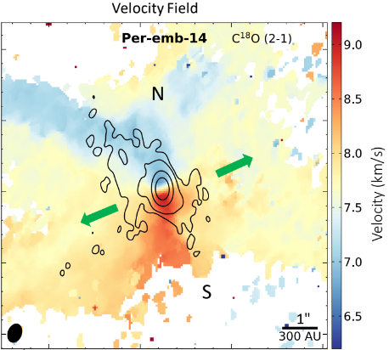
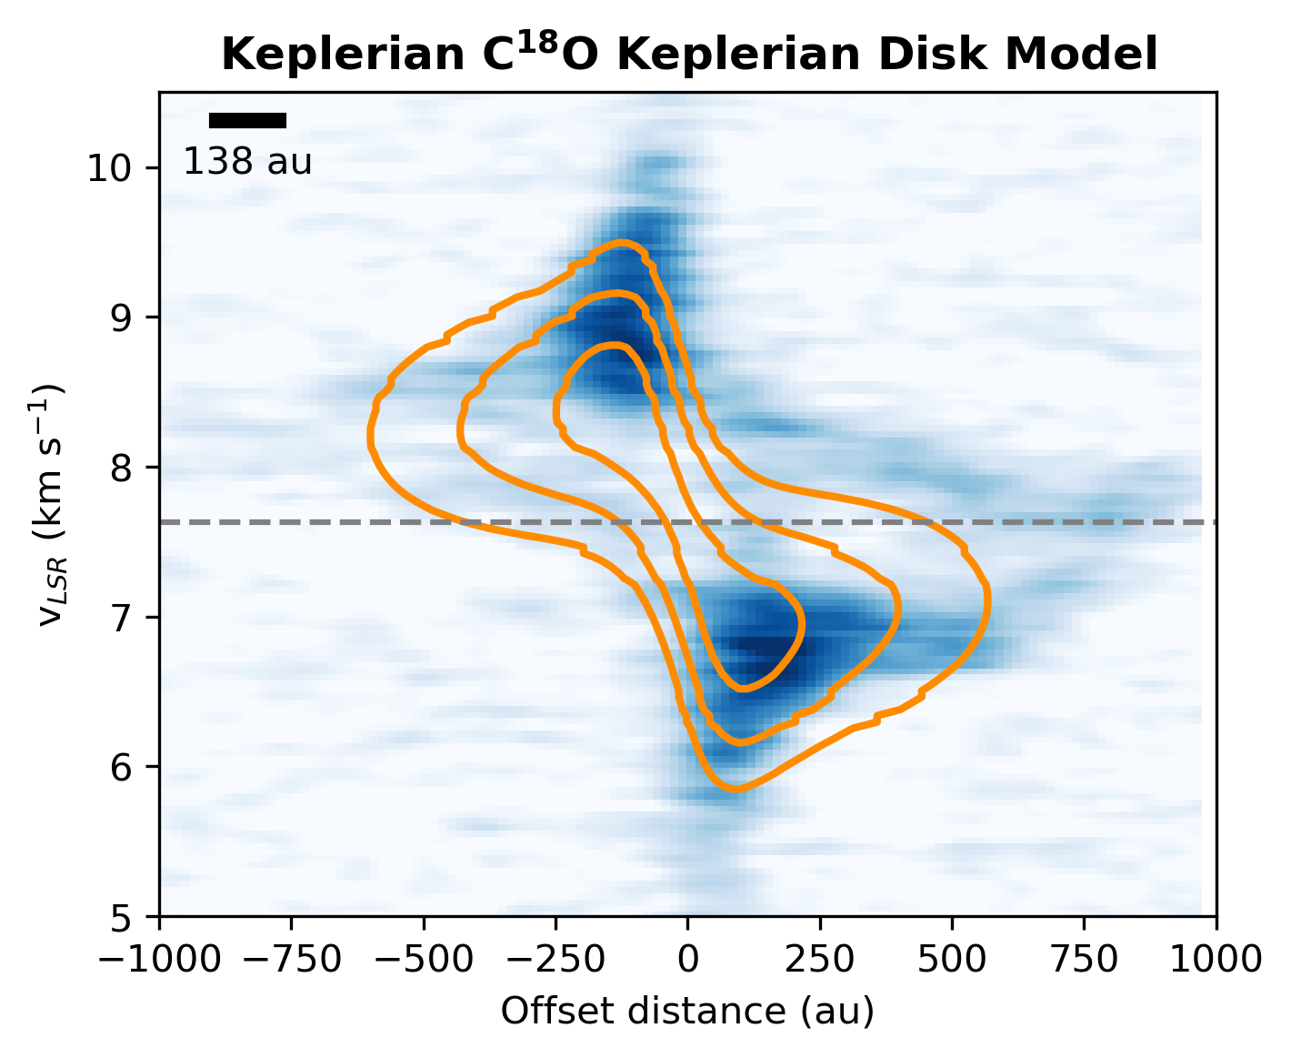
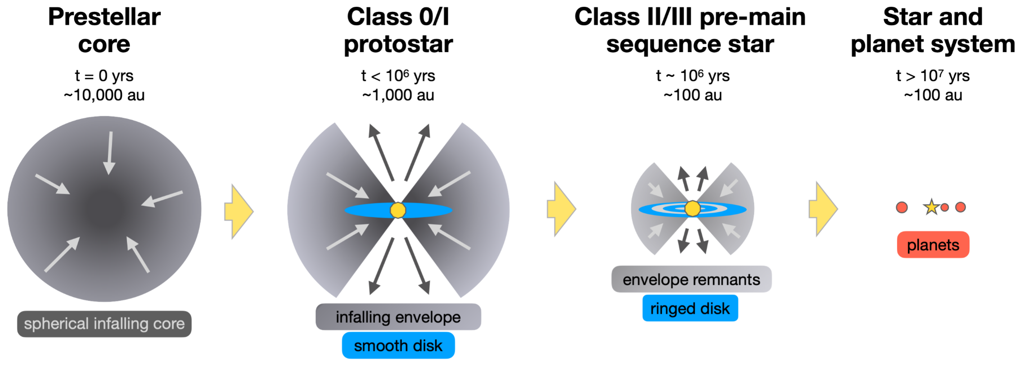
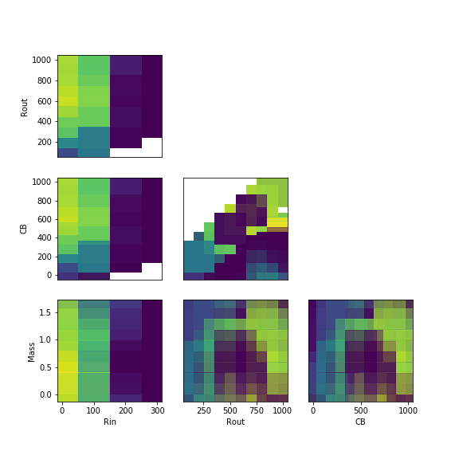
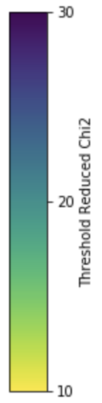
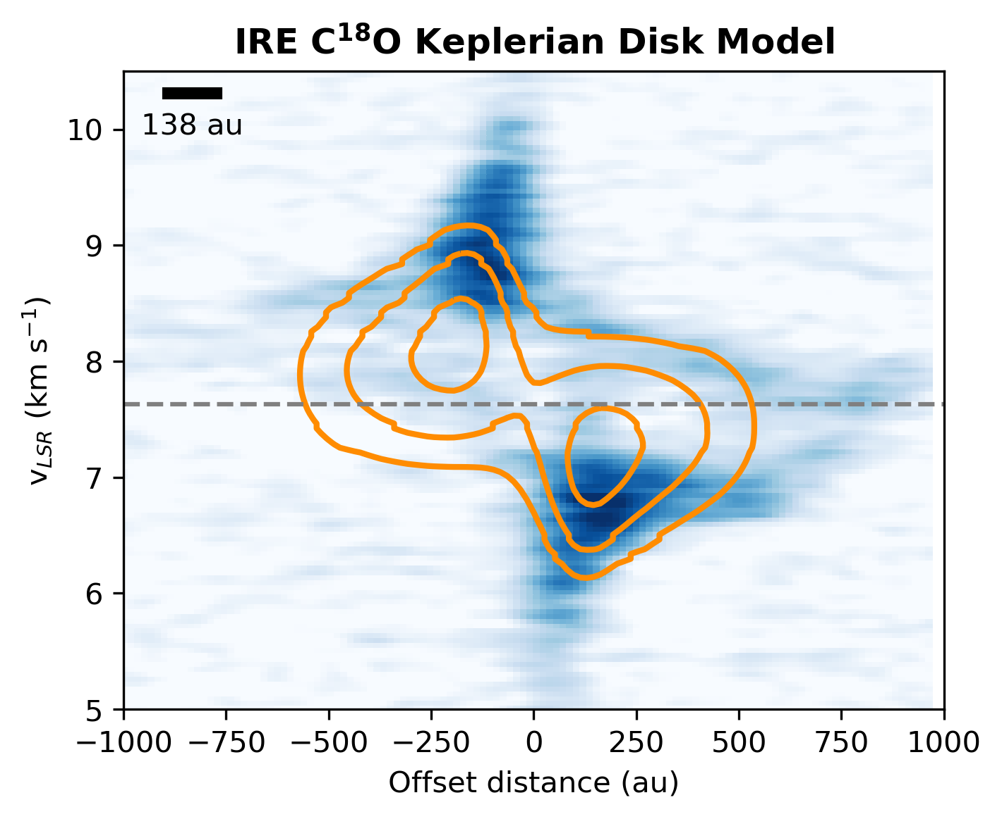
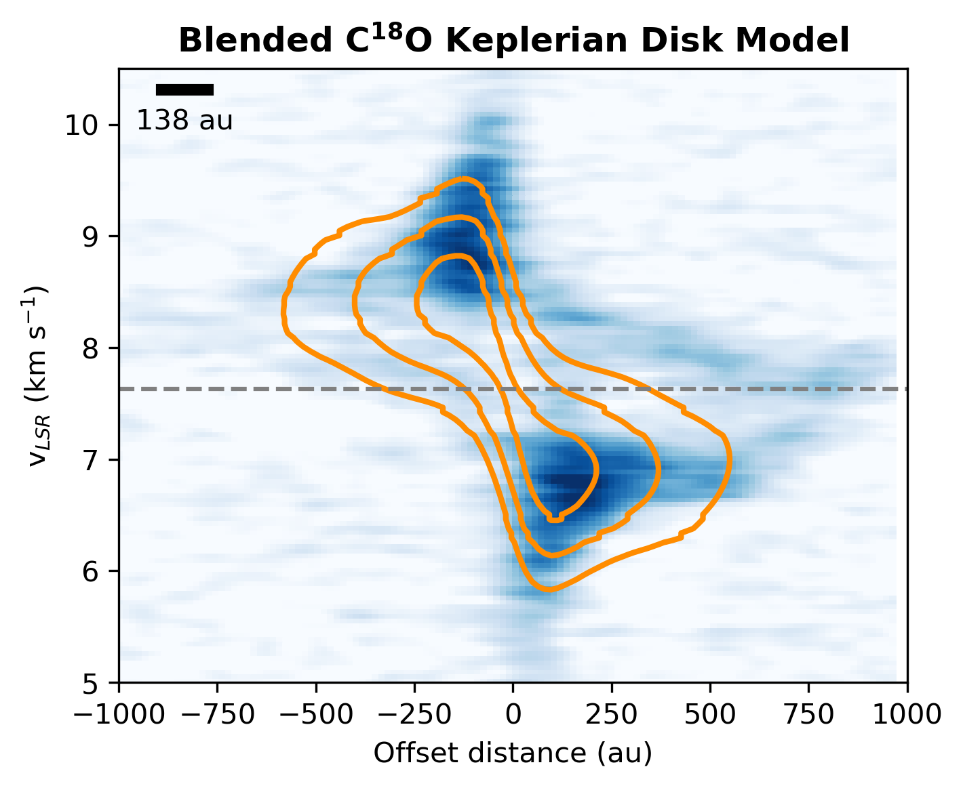
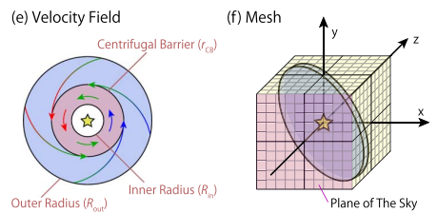



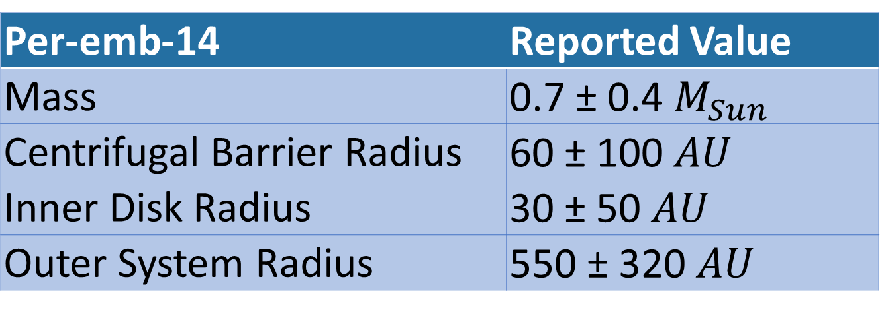
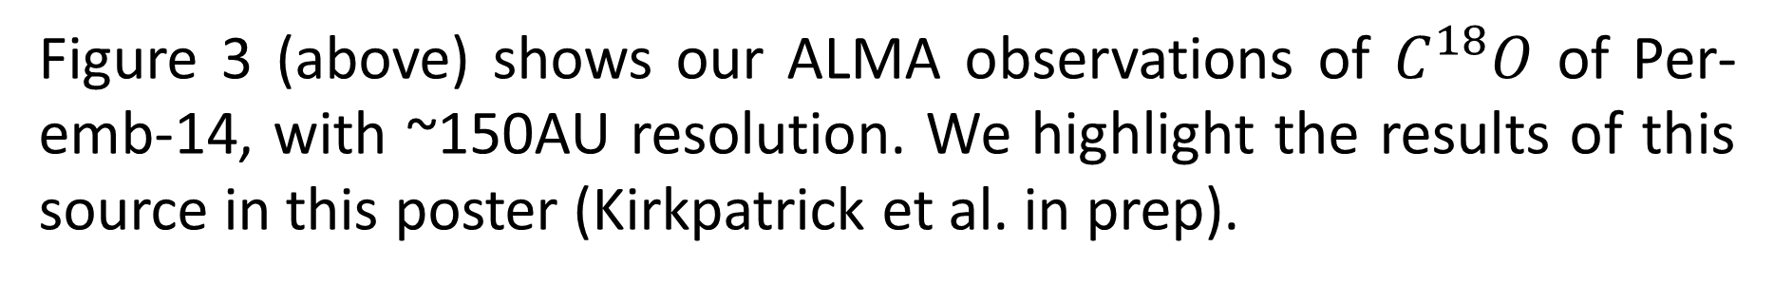

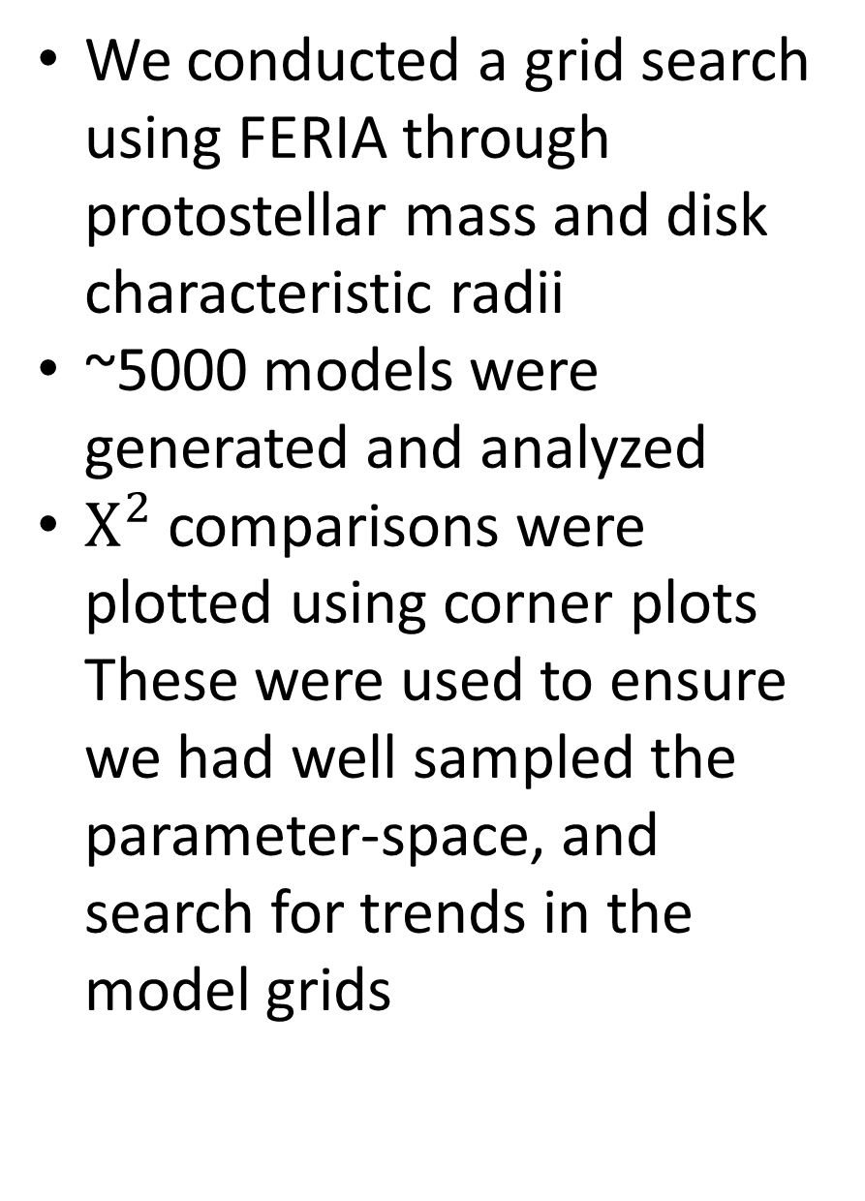
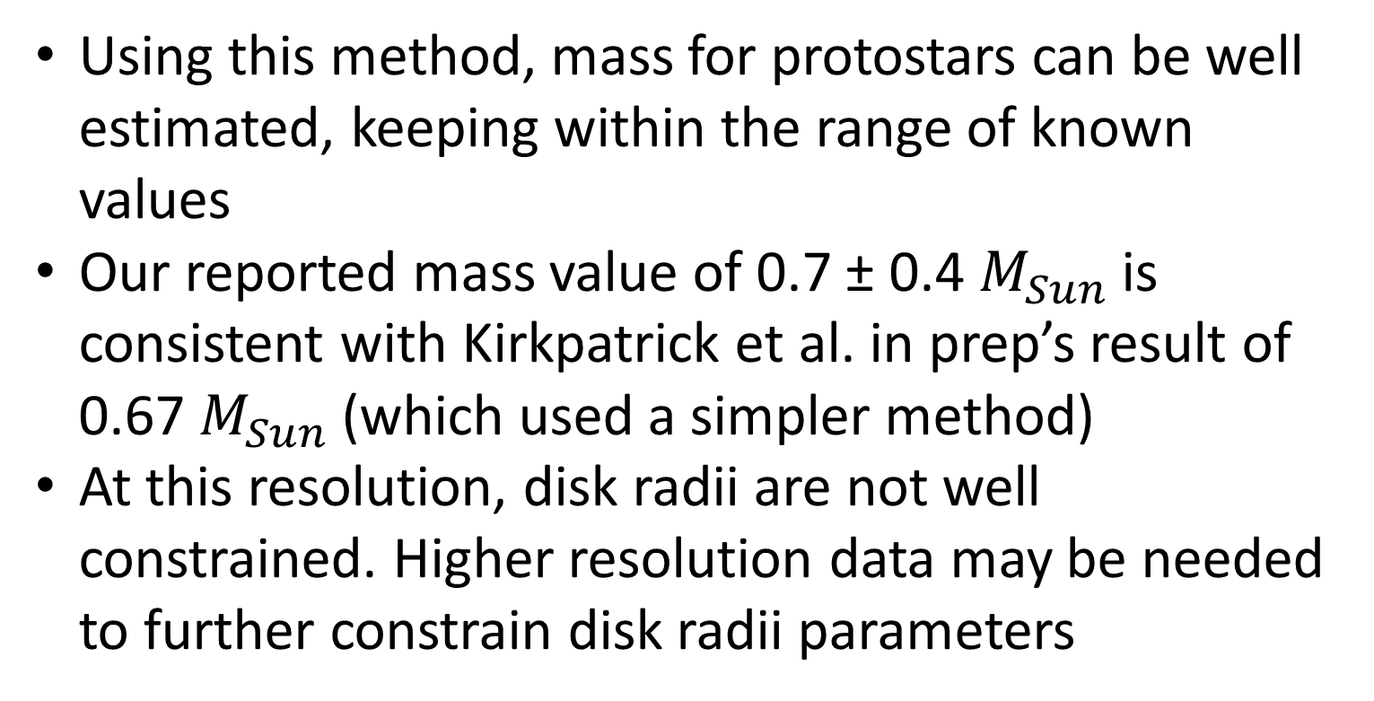
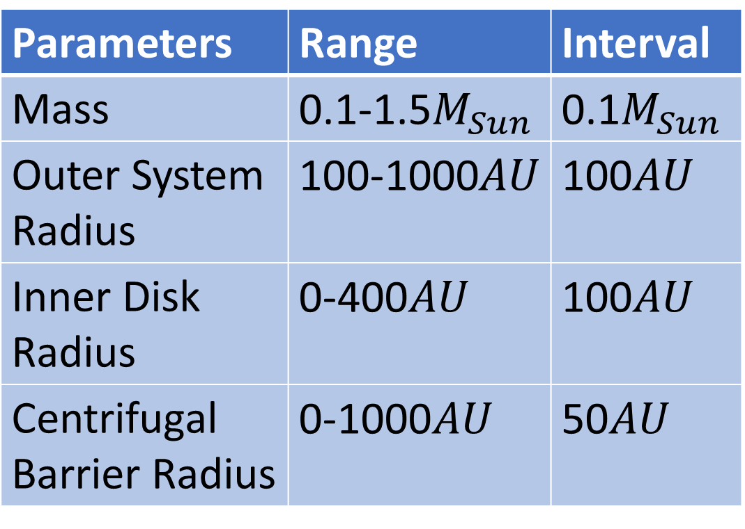

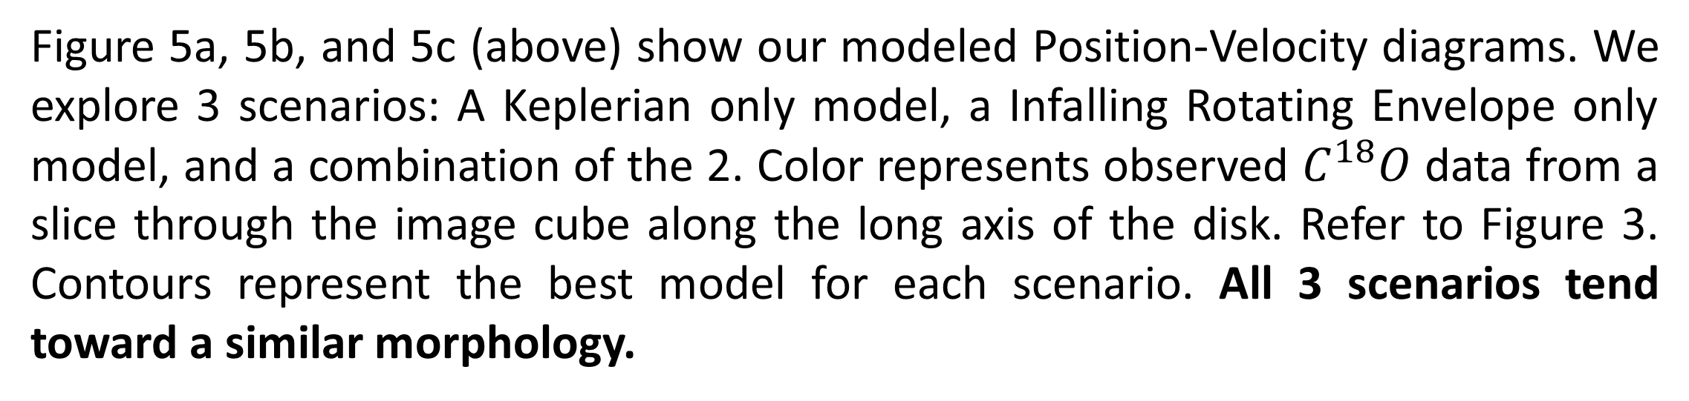
Studying Infall Towards 10 Class 0/I Protostars Using ALMA Data and FERIA
Andrew Milne^{1, 2}, Dominique Seguara-Cox² , Stella Offner²
¹Department of Physics and Astronomy, College of Liberal Arts and Sciences, The University of Iowa, Iowa City IA
²Department of Astronomy, College of Natural Sciences, University of Texas at Austin, Austin TX
Introduction
Figures and Models of the Class 0 Protostar Per-emb-14
The youngest protostars—in the Class 0/I phase—are elusive to detect, as they are heavily shielded by the gas and dust that collapses to form them. As of now, only ~25 Class 0/I protostars have had their mass measured, each in individual studies, not a systematic characterization.
This summer I modeled infall and rotation towards 10 Class 0/I protostars. This resulted in the first sample of protostars with masses measured systematically, using multiple dynamical models.
3
Table 1: Parameters explored
We conducted a grid search using FERIA through protostellar mass and disk characteristic radii
~5000 models were generated and analyzed
$Χ^{2}$comparisons were plotted using corner plots These were used to ensure we had well sampled the parameter-space, and search for trends in the model grids
Parameters | Range | Interval
Mass | 0.1-1.5$M_{Sun}$ | 0.1$M_{Sun}$
Outer System Radius | 100-1000$AU$ | 100$AU$
Inner Disk Radius | 0-400$AU$ | 100$AU$
Centrifugal Barrier Radius | 0-1000$AU$ | 50$AU$
5b
Keplerian $C^{18}O$ Model
S
N
Figure 3 (above) shows our ALMA observations of $C^{18}O$ of Per-emb-14, with ~150AU resolution. We highlight the results of this source in this poster (Kirkpatrick et al. in prep).
1
4
Figure 4 (below) shows a corner plot of the models. Parameters with yellower values on average better fit the observed data. These can distinguish the local minima and narrow in on accurate parameters.
IRE $C^{18}O$ Model
5a
Blended $C^{18}O$ Model
5c
Figure 1 shows a schematic of the star formation process (Pineda et al. 2022 and Segura-Cox et al. in prep).
S
N
S
N
Methods
We use FERIA: Flat Envelope model with Rotation and Infall under Angular momentum conservation (Oya et al. 2022)
We calculate the Χ² between model and observed data cubes
Using Χ², we rank our models, and after pruning the data, we recover parameters of the observed disk and protostar
Figure 5a, 5b, and 5c (above) show our modeled Position-Velocity diagrams. We explore 3 scenarios: A Keplerian only model, a Infalling Rotating Envelope only model, and a combination of the 2. Color represents observed $C^{18}O$ data from a slice through the image cube along the long axis of the disk. Refer to Figure 3. Contours represent the best model for each scenario. All 3 scenarios tend toward a similar morphology.
2
Results
Conclusion
Acknowledgments
Per-emb-14 | Reported Value
Mass | 0.7 ± 0.4 $M_{Sun}$
Centrifugal Barrier Radius | 60 ± 100 $AU$
Inner Disk Radius | 30 ± 50 $AU$
Outer System Radius | 550 ± 320 $AU$
Using this method, mass for protostars can be well estimated, keeping within the range of known values
Our reported mass value of 0.7 ± 0.4 $M_{Sun}$ is consistent with Kirkpatrick et al. in prep’s result of 0.67 $M_{Sun}$ (which used a simpler method)
At this resolution, disk radii are not well constrained. Higher resolution data may be needed to further constrain disk radii parameters
This work is supported by NSF REU grant AST-2244278 (PI: Jogee). Segura-Cox is supported by NSF AAPF award AST-2102405. Offner is supported by NSF AAG-2107942.
Personal Website
Figure 2 shows how FERIA makes image cubes, and uses parameters to model (Oya et al. 2022).
Table 2 shows the reported values for Per-emb-14 derived from our methods.

